Slide 1
Chapter four
INHERITANCE

Slide 2
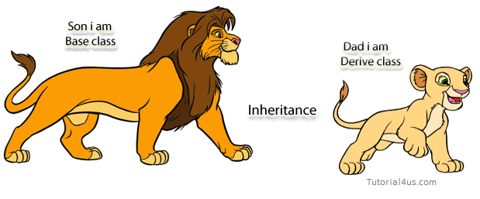
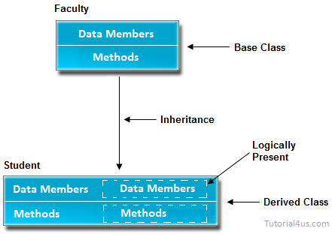
Inheritance

Slide 3
4.1 Introduction
Inheritance provided mechanism that allowed a class to inherit property of another class.
Inheritance allows a software developer to derive a new class from an existing one,
The process of obtaining the data members and methods from one class to another class
Purpose:
reuse,
enhancement,
adaptation,
For Method Overriding (so runtime polymorphism can be achieved).
Inheritance models the is-a relationship.
If class E is an extended class of class B, then any object of E can act-as an object of B

Slide 4
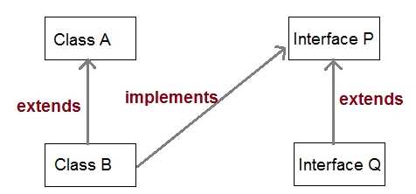
Cont…
Inheritance defines is-a relationship between a Super class and its Subclass.
extends and implements keywords are used to describe inheritance in Java.
super class (a base class)..A
subclass (a. derived class, extended class)…B

Slide 5
Examples:
Syntax of Java Inheritance
class Subclass-name extends Superclass-name
{ //methods and fields }
Eg-1
class Parent {
public void p1() {
System.out.println("Parent method");
} }
public class Child extends Parent {
public void c1() {
System.out.println("Child method"); }
public static void main(String[] args) {
Child cobj = new Child(); cobj.c1(); //method of Child class cobj.p1(); //method of Parent class
} }

Slide 6
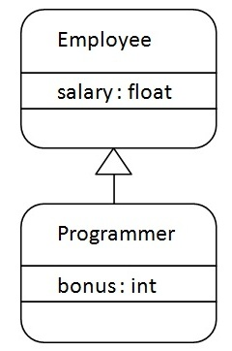
Cont…
Eg-2
class Employee{
float salary=40000;
}
class Programmer extends Employee{
int bonus=10000;
public static void main(String args[]){
Programmer p=new Programmer();
System.out.println("Programmer salary is:"+p.salary);
System.out.println("Bonus of Programmer is:"+p.bonus);
}
}
Output?
What if salary is private?

Slide 7
Eg-3
class Dictionary extends Book { private int defns = 5000;
public void definitionMessage() { System.out.println
("Number of defns:" + defns);
System.out.println("Definitions per page: " + defns/pages);
}
}
class Book{
protected int pages=150;
public void pageMessage(){
System.out.println
("Number of pages:"+ pages);
}
}

Slide 8
4.2 Advantages of Inheritance
If we develop any application using concept of Inheritance than that application have following advantages,
Application development time is less.
Application take less memory.
Application execution time is less.
Application performance is enhance (improved).
Redundancy (repetition) of the code is reduced or minimized so that we get consistence results and less storage cost.
Note: In Inheritance the scope of access modifier increasing is allow but decreasing is not allow.
Suppose in parent class method access modifier is default then it's present in child class with default or public or protected access modifier but not private(it decreased scope).

Slide 9
4.3 Access Control and Inheritance
The following rules for inherited methods are enforced
Methods declared public in a superclass also must be public in all subclasses.
Methods declared protected in a superclass must either be protected or public in subclasses; they cannot be private.
Methods declared private are not inherited at all, so there is no rule for them.
Eg:-class Employee{
private/public/protected/default float salary=40000;
}
class Programmer extends Employee{
int bonus=10000;
public static void main(String args[]){
Programmer p=new Programmer();
Accessing super-calss Data???
}

Slide 10
4.4 Types of Inheritance
Based on number of ways inheriting the feature of base class into derived class we have five types of inheritance; they are:
Single inheritance
Multiple inheritance
Hierarchical inheritance
Multilevel inheritance
Hybrid inheritance
Syntax
class ClassName-2 extends ClasssName-1
{
variable declaration;
Method declaration;
}

Slide 11
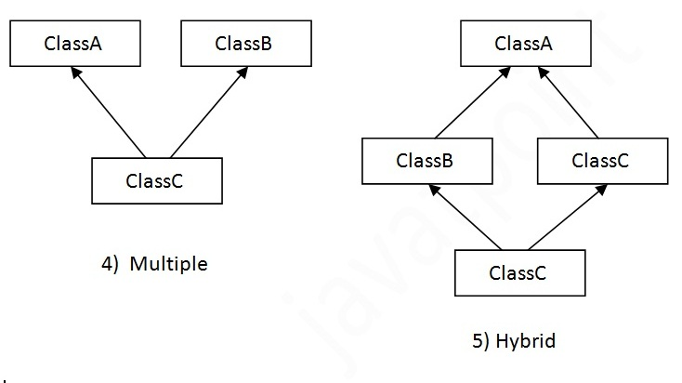
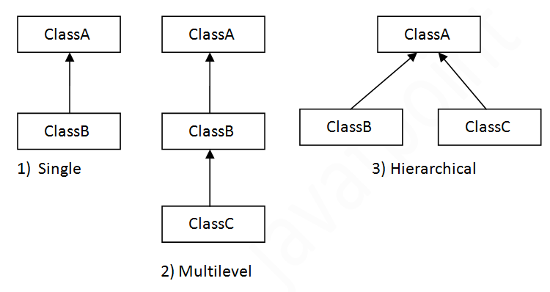
Pictorially:
Class D

Slide 12
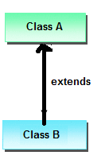
1. Single Inheritance
In single inheritance there exists single base class and single derived class.
Example: class Faculty
{
float salary=30000;
}
class Science extends Faculty
{
float bonous=2000;
public static void main(String args[])
{
Science obj=new Science();
System.out.println("Salary is:"+obj.salary);
System.out.println("Bonous is:"+obj.bonous);
}
}

Slide 13
Eg-2(two-classes in one package)
public class person {
private String name;
private int age;
public person(String n,int a)
{
this.name=n;
this.age=a;
}
public String getName()
{return name; }
public int getAge()
{ return age; }

Slide 14
Cont…
public static void main(String args[])
{
sampleStudent st=new sampleStudent("kk",20);
st.setGrade(3.6);
String n=st.getGrade();
System.out.println(“result=”+n);
}
}
import java.util.Scanner;
public class sampleStudent extends Person {
private double cum;
public sampleStudent(String n,int a)
{ super(n,a);
}public void setGrade(double cum)
{ this.cum=cum;
}
public String getGrade()
{ String s=super.getName()+" \t"+super.getAge()+"\t "+cum;
return s;}

Slide 15
Super vs super()
Super…key word
super represent current instance of the parent class
super in Java is for accessing instance variables of it's parent (if it is the same instance-to remove ambiguity)
You can not reassign the (this and super variable) because you can not assign a new value to final variable this".-they are special variables and they are final
super with variables and methods: super is used to call super class variables and methods by the subclass object when they are overridden by subclass.(keyword)
Both this and super are non static and can not be used in static context, which means you can not use this and super keyword inside main method in Java(compilation error)

Slide 16
Example (predict output?)
System.out.println("Super class x value: " + super.x);
System.out.println("Sum of x values: " + (x + super.x));
}
public static void main(String args[])
{
Demo d1 = new Demo();
d1.display();
}
}
Output?
class Test
{
int x = 10;
}
public class Demo extends Test
{
int x = 100;
public void display()
{
System.out.println("Subclass x value: " + x);

Slide 17
Cont…
EG:
class Test
{
public void display()
{
System.out.println("From super class");
}
}
public class Demo extends Test
{
public void display()
{
super.display();
System.out.println("From subclass");
super.display();
}
public static void main(String args[])
{
Demo d1 = new Demo();
d1.display(); }
}

Slide 18
Super() vs this()
class B extends A{
B(){
this("");
System.out.println("B's no constructor");}
B(String args){
super("");
System.out.println("B's one -string constructor"); }
}
public class Test {
public static void main(String args[]) {
B b = new B(); }}
super() is used to call super class constructor from subclass constructor
this and super can be used in constructor chaining to call another constructor
e.g. this() and super() respectively calls no argument constructor of child and parent class.
class A{
A(){System.out.println("A's no-constructor"); }
A(String args){
System.out.println("A's one –string constructor");}
}
output?

Slide 19
Can you use both this() and super() in a Constructor?
NO, because both super() and this() must be first statement inside a constructor. Hence we cannot use them together.

Slide 20
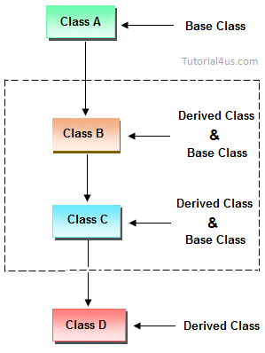
2. Multi-level Inheritance
In Multilevel inheritances there exists single base class, single derived class and multiple intermediate base classes.
Single base class + single derived class + multiple intermediate base classes.
Intermediate base classes
An intermediate base class is one in one context with access derived class and in another context same class access base class.

Slide 21
Examples:
class Science extends DA
{
float bonous=2000;
public static void main(String args[])
{
Science obj=new Science();
obj.total_sal=obj.salary+obj.hra+obj.da+obj.bonous;
System.out.println("Total Salary is:"+obj.total_sal);
}
}
Output??
class Faculty
{
float total_sal=0, salary=30000;
}
class HRA extends Faculty
{
float hra=3000;
}
class DA extends HRA
{
float da=2000;
}

Slide 22
Exercises:
Define a class Person with members(name, salary, age,& member-methods())
Define a child class Instructor with members(name, age, salary,acadamic-rank,member-methods())
Input values
Using input from keyboard(Scanner/JOptionPane)
What if for N-number of objects
Show a multi-level inheritance using the following classes:
College
School
Department
Student
Input values
Using input from keyboard(Scanner/JOptionPane)
What if for N-number of objects
Create your own classes interfaces and methods to show multiple inheritance is possible in java?

Slide 23
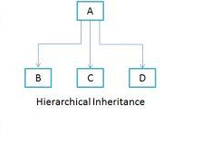
3. Hierarchical Inheritance
when a class has more than one child classes (sub classes) or
in other words more than one child classes have the same parent class then such kind of inheritance is known as hierarchical.

Slide 24
Examples
Class A{
public void methodA()
{ System.out.println("method of Class A");
}}
Class B extends A{
public void methodB()
{System.out.println("method of Class B");
}}
Class C extends A{
public void methodC()
{System.out.println("method of Class C");
}}
Class MyClass{
public void methodSampl()
{System.out.println("method sample");
}
public static void main(String args[])
{
B obj1 = new B();
C obj2 = new C();
obj1.methodA();
obj2.methodA();
}
}
Output??

Slide 25
4. Multiple Inheritance
In multiple inheritance there exist multiple classes and singel derived class.
The concept of multiple inheritance is not supported in java through concept of classes
but it can be supported through the concept of interface.
Why?
To reduce the complexity (avoid ambiguity)and simplify the language, multiple inheritance is not supported in java.
Consider a scenario where A, B and C are three classes. The C class inherits A and B classes. If A and B classes have same method and you call it from child class object, there will be ambiguity to call method of A or B class.
Since compile time errors are better than runtime errors, java renders compile time error if you inherit 2 classes. So whether you have same method or different, there will be compile time error now.

Slide 26
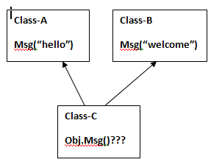
Example:
class C extends A,B{
Public Static void main(String args[]){
C obj=new C();
obj.msg();
}
}
Which msg() will be called???
Ambiguity(Error)?
class A{
void msg()
{
System.out.println("Hello");
}
}
class B{
void msg()
{
System.out.println("Welcome");
}
}

Slide 27
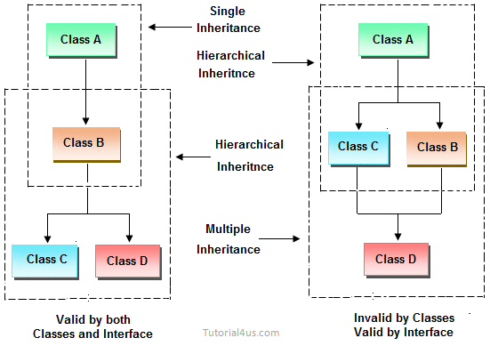
5. Hybrid Inheritance
Combination of any inheritance type
In the combination if one of the combination is multiple inheritance then the inherited combination is not supported by java through the classes concept

Slide 28
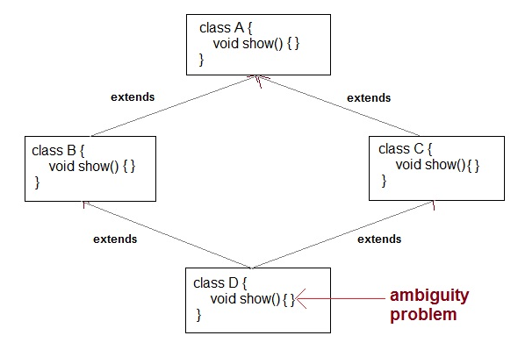
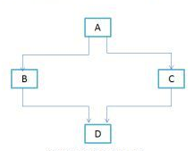
Why Java Doesn’t support Multiple & Hybrid Inheritance?
It is just to remove ambiguity,
One of the most common scenario is Diamond problem.

Slide 29
Multiple inheritance using Interfaces
interface X{
public void myMethod();
}
interface Y{
public void myMethod();
}
class Demo implements X, Y{
public void myMethod() {
System.out.println(" implementation");
}
}

Slide 30
Eg-2(diamond through interface)
class D implements B, C{
public void methodA()
{ System.out.println("MethodA"); }
public void methodB() { System.out.println("MethodB"); }
public void methodC() { System.out.println("MethodC"); }
public static void main(String args[]) {
D obj1= new D(); obj1.methodA(); obj1.methodB(); obj1.methodC(); }}
interface A{
public void methodA();
}
interface B extends A{
public void methodB();
}
interface C extends A{
public void methodC();
}

Slide 31
Default methods
Example
public interface SE
{ default void takeOOP()
{ System.out.println(“we take java-course !!");
}
}
public class Student implements SE
{ public static void main(String[] args)
{Student s1 = new Student();
s1.takeOOP();
}}
Default methods enable you to add new functionality to the interfaces and
ensure backward compatibility for existing classes which implement that interface.
As their name implies, default methods in interfaces are methods which will be invoked by default – if not overridden in implementing classes

Slide 32
Default Methods
Eg2-
Interface SE
{ default void takeOOP(){
System.out.println(“we take java!!");
}}
interface CS
{ default void takeDS(){
System.out.println(“we take DS-course !!");
}}
public class Student implements SE,CS
{ public static void main(String[] args) {
Student s1 = new Student();
s1.takeOOP();
s1.takeDS();
}}
What if the student implement it d/tly?
interfaces were only for declaring the contracts which implementing classes MUST implement
(except the implementing class in not abstract itself). So there was no specific behavior attached with interfaces which a class can inherit. (multiple inheritance is a bluff)
But because of default methods(in java-8), interfaces have behavior as well.
So now if a class implement two interfaces and both defines default methods, then it is essentially inheriting behaviors from two parents (which is multiple inheritance.)

Slide 33
Cont…
public class Student implements SE, DS
{
public static void main(String[] args) {
Student s1= new Student();
//s1.takeOOP();???
}
}
So it uses interface’s reference like below.
SE.super.takeOOP(); or
CS.super.takeOOP();
What if both interfaces decide to define a new method with same name. ?? Conflict?
interface SE
{ default void takeOOP(){
System.out.println(“we take java !!");
}}
interface CS
{default void takeOOP(){
System.out.println(“we take DS!!");
}}

Slide 34
Eg-Through Default Methods
interface A2 {
default public void msgA(){
System.out.println("mydata");}
}
interface A3 extends A2 {
default public void msgA(){
System.out.println("boss-A's data");
}
public void msgA3();
}
interface A4 extends A2{
default void msgA(){
System.out.println("student:A's data");
}
public void msgA4();
}
public class Test implements A3,A4{
public void msgA()
{ A3.super.msgA();
//A4.super.msgA();
}
public void msgA3(){
System.out.println("boss:mydata");
}
public void msgA4(){
System.out.println("student:mydata");}
public static void main(String args[]){
Test d1=new Test();
d1.msgA();
d1.msgA3();
d1.msgA4();
}}

Slide 35
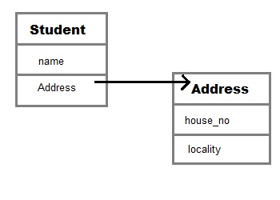
Aggregation (HAS-A)
HAS-A relationship is based on usage, rather than inheritance.
class A has-a relationship with class B, if code in class A has a reference to an instance of class B.
Eg:
class Student{
String name;
Address ad;
}
We can say that
Student has-a Address.
Student code can use Address reference to invoke methods on the Address, and get Address behavior.
Aggregation allow you to design classes that follow good Object Oriented practices.(provide code reusability).

Slide 36
Example:
class Book{
String name;
int price;
Author auth;
Book(String n,int p,Author at) {
this.name=n;
this.price=p;
this.auth=at; }
public void showDetail()
{ System.out.println("Book is"+name);
System.out.println("price "+price);
System.out.println("Author is "+auth.getAuthorName()); }}
class Test{
public static void main(String args[]) { Author ath=new Author(“TK",25);
Book b=new Book("Java",300,ath); b.showDetail();
}}
class Author{
String authorName;
int age;
Author(String name,int age){
this.authorName=name;
this.age=age;
}
public String getAuthorName()
{ return authorName; }
public int getAge()
{ return age; }
public String getPlace()
{ return place; }
}

Slide 37
Cont…
When to use Inheritance and Aggregation?
When you need to use property and behaviour of a class without modifying it inside your class. In such case Aggregation is a better option.
Whereas when you need to use and modify property and behaviour of a class inside your class, its best to use Inheritance.
Reading Assignment???
What is Composition in java?
Composition is restricted form of Aggregation.
Eg a class Dog can not exist without Leg
a class Car cannot exist without Engine.
What is anonymous class in java?

Slide 38
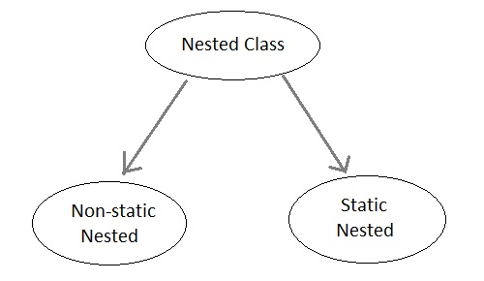
Nested Classes
A class within another class is known as Nested class.
The scope of the nested is bounded by the scope of its enclosing class.
1. Static Nested Class
A static nested class is the one that has static modifier applied. Because it is static it cannot refer to non-static members of its enclosing class directly.
Because of this restriction static nested class is seldom used.

Slide 39
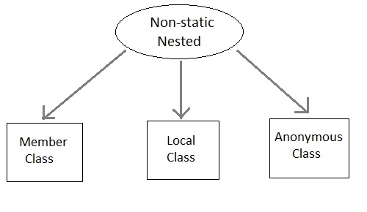
Cont…
2. Non-static Nested class
Non-static Nested class is most important type ( Inner class).
It has access to all variables and methods of Outer class and may refer to them directly.
But the reverse is not true, that is, Outer class cannot directly access members of Inner class.
an Inner class can be created only within the scope of Outer class.
Java compiler generates an error if any code outside Outer class attempts to instantiate Innerclass.

Slide 40
Example:-1(member)&2(local)
class Outer{
int count;
public void display() {
for(int i=0;i<5;i++) {
class Inner {
public void show()
{
System.out.println("Inside inner "+(count++));
} }
Inner in=new Inner();
in.show();
} }}
class Test{
public static void main(String[] args) { Outer ot=new Outer();
ot.display();
}
Output??
(Note K++ vs ++k..?)
class Outer{
public void display() {
Inner in=new Inner();
in.show();
}
class Inner {
public void show() {
System.out.println("Inside inner");
} }
}
class Test{
public static void main(String[] args)
{ Outer ot=new Outer();
ot.display();
}}Output?
Inside Inner

Slide 41
Predict output?
public int product2()
{return v*x;//accesing Outer class data in inner-calss?
}}
}
public class Test2 {
public static void main(String[] args)
{ Outer1 ot=new Outer1();
ot.sum();
//Inner cc=new Inner();//is that possible?
//Outer.Inner gg=ot.new Inner(); //inner outside/in main()
//System.out.println(ot.rr.product());//(if Inner rr=new Inner() is declared above the inner class signatur)
}
}..what if Inner is static?
class Outer1{
int x=2;
public void sum() {
Inner in=new Inner();
System.out.println( in.product());
System.out.println( in.product2());
}
public void sum2() {
//System.out.println("result="+(x+v));//accesing inner-class data in outer
}
//Inner rr=new Inner();
class Inner {
int v=5;
public int product() {
return v*v;
}

Slide 42
Shadowing?
public static void main(String... args) {
ShadowTest st = new ShadowTest(); ShadowTest.FirstLevel fl = st.new FirstLevel(); fl.methodInFirstLevel(23);
}}
Predict?
23
1
0
public class ShadowTest {
public int x = 0;
class FirstLevel {
public int x = 1;
void methodInFirstLevel(int x)
{
System.out.println("x = " + x); System.out.println("this.x = " + this.x); System.out.println("ShadowTest.this.x = " + ShadowTest.this.x);
}
}

Slide 43
Summary/Caution:
If we are do not want to give some of the features of base class to derived class then such features of base class must be as private
hence private features of base class are not inheritable or accessible in derived class.
Data members and methods of a base class can be inherited into the derived class but constructors of base class can not be inherited
because every constructor of a class is made for initializing its own data members but not made for initializing the data members of other classes.
An object of base class can contain details about features of same class but never contains the details about special features of its derived class (scope of base class object).
For each and every class in java there exists an implicit predefined super class called java.lang.Object.
because it providers garbage collection facilities to its sub classes for collecting un-used memory space and improved the performance of java application

Slide 44
Cont…
In java programming one derived class can extends only one base class
because java programming does not support multiple inheritance through the concept of classes, but it can be supported through the concept of Interface.
Whenever we develop any inheritance application first create an object of bottom most derived class but not for top most base class.
When we create an object of bottom most derived class, first we get the memory space for the data members of top most base class, and then we get the memory space for data member of other bottom most derived class.
Bottom most derived class contains logical appearance for the data members of all top most base classes.
If we do not want to give the features of base class to the derived class then the base class must final (use final keyword)
hence final base classes are not reusable or not inheritable.

Slide 45
Thank You

